Slide 1
G2M insight for Cab Investment firm
Deborah Adeyemi
June-2021

Slide 2
Background –G2M(cab industry)
• There has been remarkable growth in the Cab Industry over the last few years, and there are several key players in the market. XYZ is a private equity firm based in the US planning to invest in the Cab industry due to the market growth.
• Objective : Identify the right investment candidate for XYZ firm by delivering actionable insights.
Here are the four sections of the analysis:
• Analysis of data
• For each cab type, a profit forecast and a number of rides are generated
• Calculating the profit potential of cab companies
• A recommendation for investing

Slide 3
Data Exploration
4 datasets provided for the analysis
Time frame of data is from 31/01/2016 to 31/12/2018.
Understanding each data set.
After merging the Cab Data with the transaction data, we found the following:
Card payments are more popular as payment modes so begs the question, why are they more popular?
i)is it because it is cheaper to use a card payment?
ii)is it because it is more convenient?
Comparing the price charged and the cost of trip for both payment modes to see if there is a significant difference
Step 1: Get the average price charged as well as the total cost of trip for each payment mode
Step 2: Visualize both and compare

Slide 4
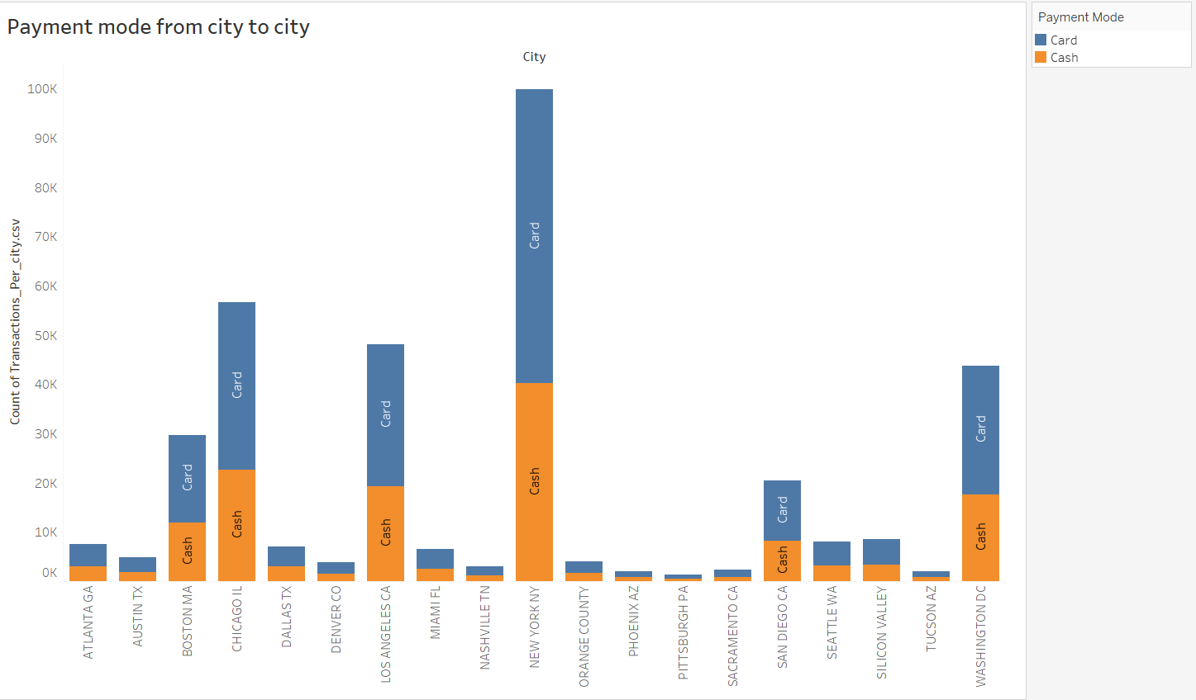
DATA ANALYSIS
PAYMENT MODE FROM CITY TO CITY

Slide 5
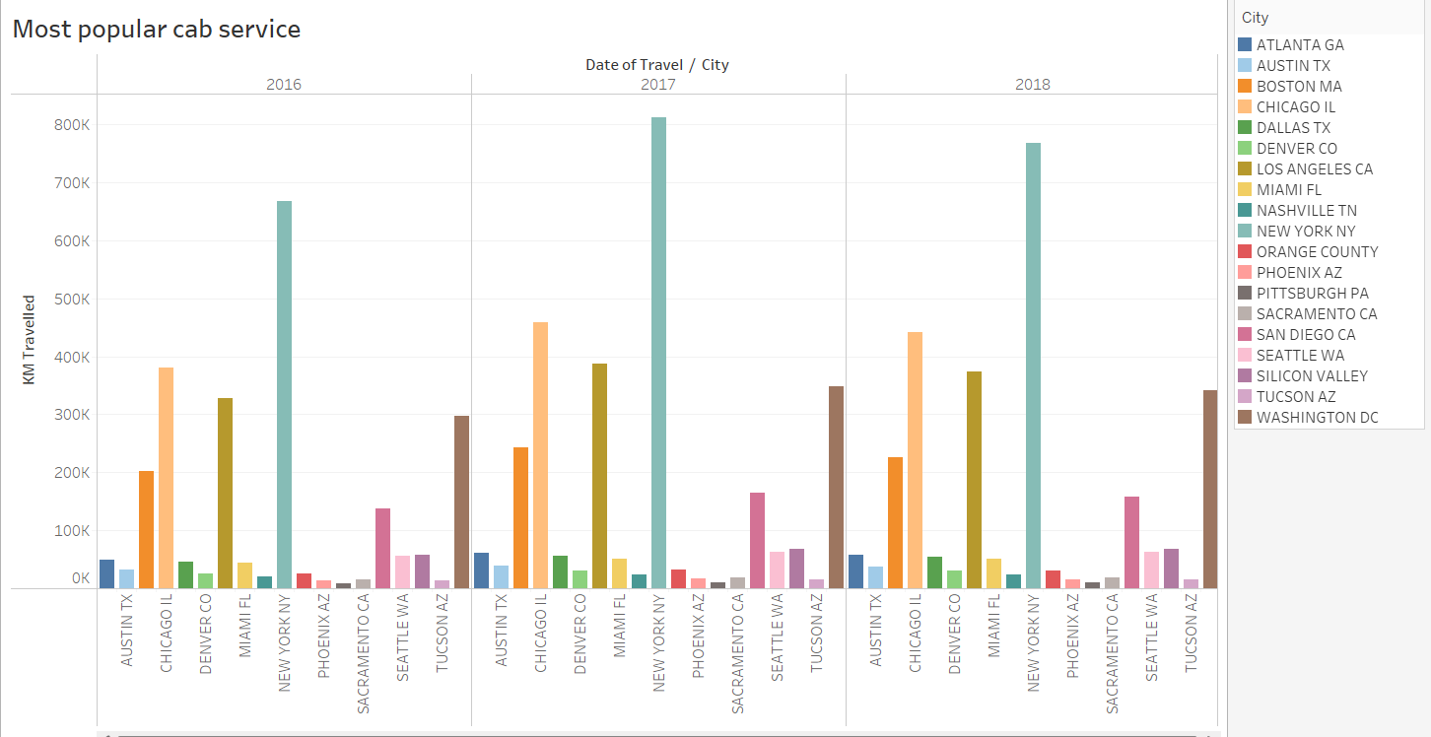
Most popular cab services

Slide 6
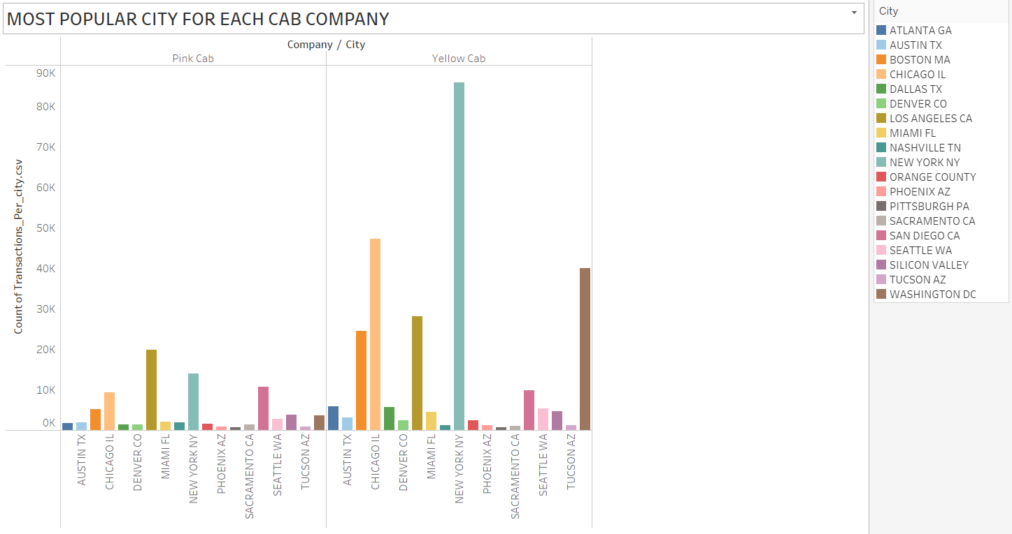
MOST POPULAR CITY FOR EACH CAB COMPANY

Slide 7
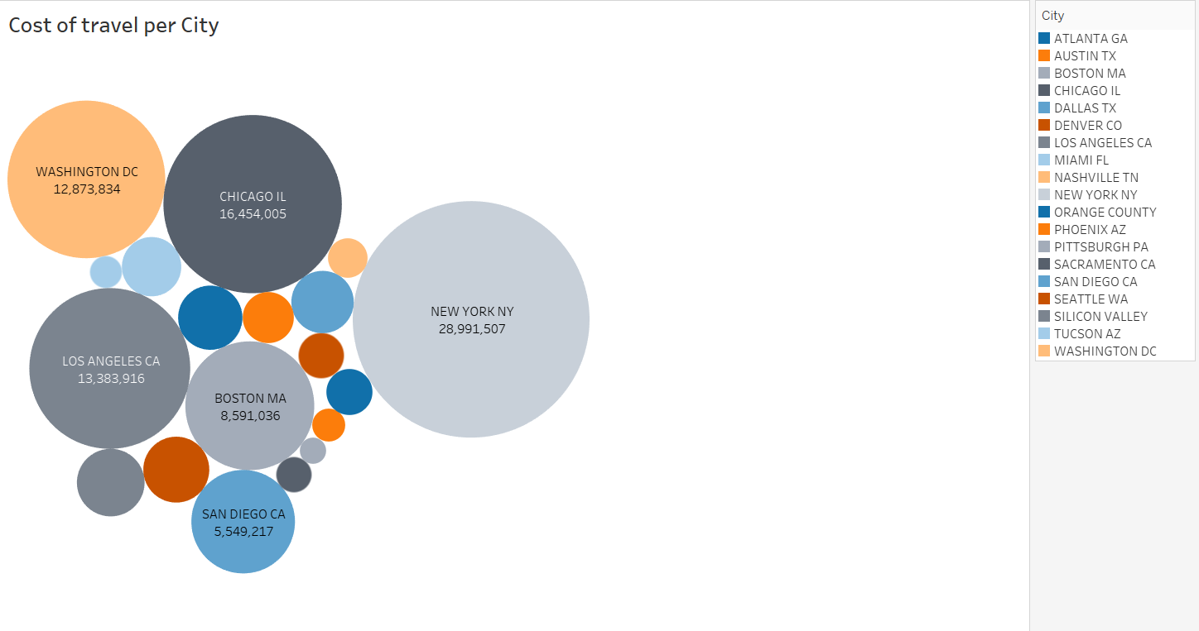
Cost of travel per city

Slide 8
Recommendation
In comparing Yellow and Pink cab companies, we have found the Yellow company to be superior on the following points:
•The Yellow Cab is performing better in the high and medium income classes, but both cabs are very in the high and medium income classes.
• Yellow cabs generate almost double profit per kilometer than Pink cabs.
•Although both the yellow and pink cabs are extremely popular among high and middle income groups, Yellow cab performs better than Pink cab on all three income years.

